Slide 1

What’s under a rock is interesting.
But why should we care?
Rebecca Williams, Senior Reporter
Notes:
I want to talk about making people care about stories about science and the environment - I’m going to go over some of the key ways to engage people and some things to avoid.

Slide 2
Keeping people on the train
We reach people who might not care about science and environment stories - or might not think they care
“Drive time” listeners in Morning Edition and All Things Considered
Notes:
When people listen to the radio, they’re usually not ONLY listening to the radio. They’re driving, cooking, watching kids, working at the same time. Other things competing for their attention. So we have to catch their attention right off the bat and KEEP it. We say - if someone gets off the train - they’re tuning away and you lose their attention, they’re gone.

Slide 3
Talk to one person
We reach more than 500,000 people each week, but we talk to just one person at a time.
Notes:
Radio is intimate. It’s me, talking to you. I’m not talking to thousands of people all in one room together. I’m just talking to you, telling you a story.

Slide 4
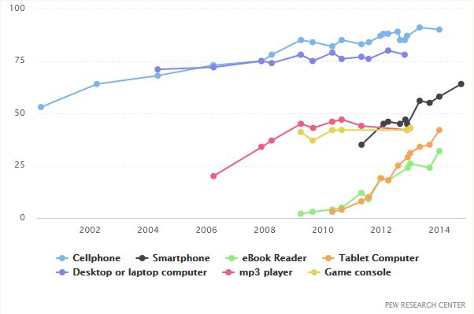
More ways to connect
Pew Research Center
Notes:
Not just a distracted RADIO audience we have to think about. You can see here why we can’t just produce one kind of story - it used to be, back when I started in radio 16 years ago, we could.

Slide 5
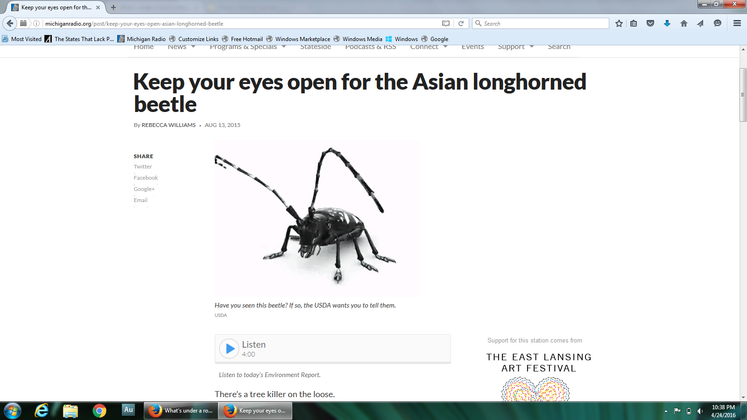
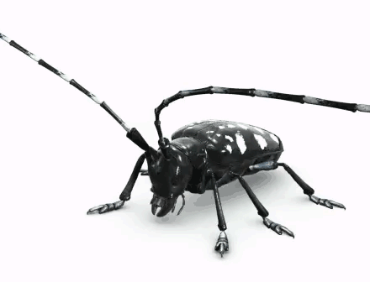
We tell every story twice.
Notes:
But now, we have to also write a different version of the story for the web, and we rewrite our stories for the EYE after we’ve written them for the EAR. So we’re always thinking about eyecatching images, videos, sometimes even gifs.

Slide 6
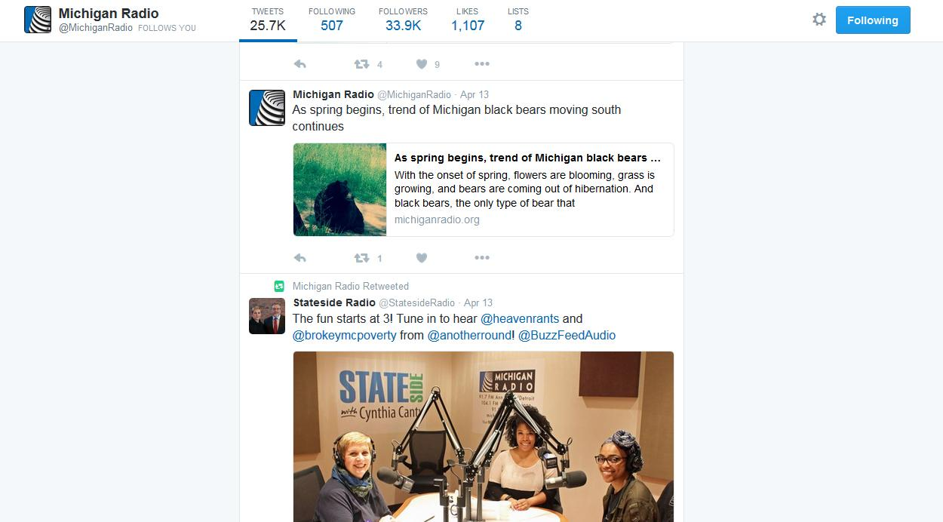
Embrace multiple platforms for storytelling
Notes:
You can experiment with different approaches to tell a story and embrace these different platforms for storytelling. Involves more work but reach more people you might not reach otherwise.
Have to evolve over time, embrace new forms of media to get message out.

Slide 7
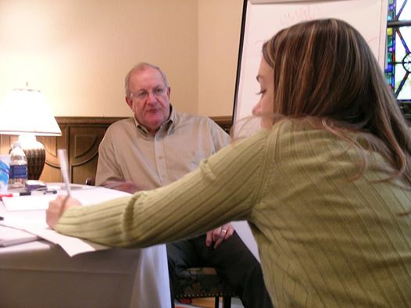
David candow, the host whisperer
“Nothing is more compelling to the human ear than the sound of another human voice.”
-David Candow
Notes:
David Candow has had a huge influence on hundreds of CBC and NPR reporters in the U-S and Canada. He earned the nickname the Host Whisperer for his talent for making radio hosts and reporters sound better and be better storytellers. A lot of the tips I’m sharing with you are inspired by David.

Slide 8
Why should we care?
Understanding why you care about what you’re telling me to care about.
And - why should it matter to me?
Notes:
People like to hear stories about other human beings. We just do. We like gossip. That doesn’t mean that I don’t want to hear about how amazing a snail is - I do. And of course - all the other creatures in our world matter. But one trick to getting people to listen to a story about a snail is understanding why YOU care about that snail. What’s so fascinating about it to YOU?

Slide 9
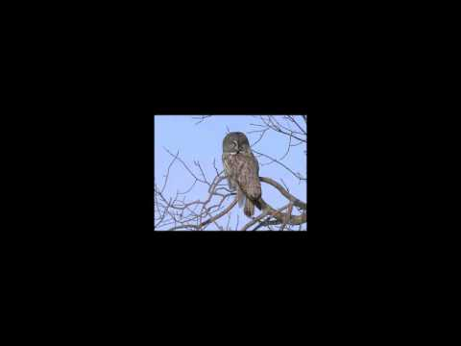
Gerry Smith
and the Great Gray Owl
Notes:
Sometimes you don’t have to spell out the why - you can hear it. Story by David Sommerstein. He’s telling us the great gray owl - it usually lives in the northern forests of Canada but back in 2005 some of the owls came south. This particular owl was the first to be spotted in New York in a decade. David just happened to be there when ornithologist Gerry Smith saw the owl.

Slide 10
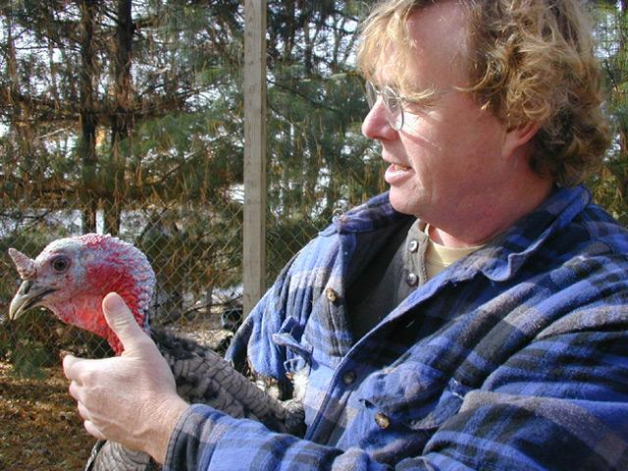
The Focus Statement
Someone doing something
for a reason.
John Harnois raises heritage breeds of turkeys because he wants to set his business apart and he wants to preserve genetic diversity.
Notes:
What we try to do is focus on one story per story. A focus statement helps you develop a clear storyline. Until you don’t know the reason WHY, you don’t know the story.

Slide 11
The basics
To focus your story or your message you need the who, the how, the what and the why.

Slide 12
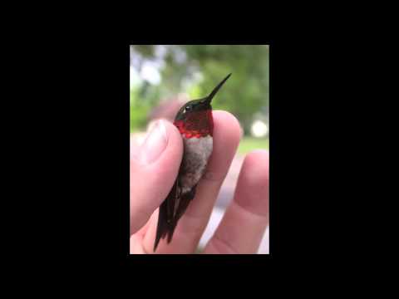
THe story’s in the details: the what and the how
Ruby-throated hummingbird. Photo by Allen Chartier.
Notes:
For me, a huge part of telling stories about science is understanding HOW the person I’m profiling does what they do. When I did a story about this guy, Allen Chartier, who bands hummingbirds, I learned that his work is so specialized that the tools his uses are meant for other things. They put them in nylon footies to weigh them. And they use diaper pins to store the leg bands on.

Slide 13
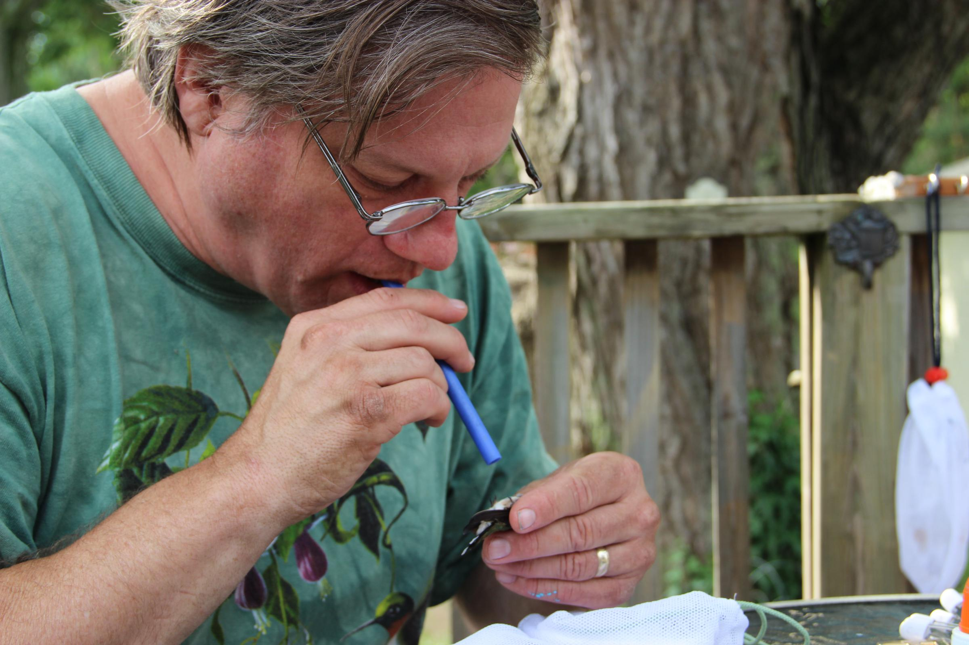
Connecting to the person behind the science
“I’d love to be paid to do this all the time, but society doesn’t value this kind of thing as highly as some other things, like baseball players. It’s got to be the passion for the subject that keeps you going.” - Allen Chartier
Notes:
So hummingbirds are charismatic MINI fauna and you could do a story that’s just about hummingbirds. But if you can also tell me about the people who do this work, who study the birds, and what drives them, you’re going to reach more people that way.
So if you have the how and the why - you have two of the basic things you need

Slide 14
PITFALL # 1: jargon
“We’ll be presenting data on the potential for there to be epigenetic changes that are associated with PBB exposure, and that is the regulation of gene expression, it’s not actually changing the DNA sequence itself.”
Notes:
I don’t think you have to avoid jargon completely - but you can do what this researcher did, which is tell me what that term means right after you say it. I think that worked, but it can also go very wrong. You can use a piece of tape in a story that just loses someone and then, again they’re off the train and they’re watching funny cat videos instead.

Slide 15
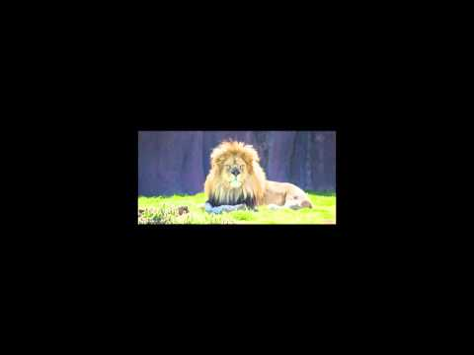
Talk like you’re talking to a guy at the bar
Notes:
This is a clip from an interview NPR reporter John Nielsen did for a story about Avian flu in zoos. During an outbreak, people were afraid to go to zoos because they thought, wrongly, there was a higher risk of catching the disease in a zoo. Nielsen’s interviewing a zoo director, and he just needs the guy to set the record straight, say that zoos actually aren’t any more dangerous than anywhere else.We’ll pick up the tape after John’s asked the question a second time, why is it safe to go to the zoo? I will preface this by saying the reporter says - you didn’t say that right - try again - I wouldn’t take that approach. But I want you to listen to how the zoo director rephrases his answer.

Slide 16

Be conversational
This doesn’t mean dumbing
something down.
It means letting people into
the “club.”
Notes:
When people first start out in radio, they usually write like they did in college. And they try to sound like they think a radio announcer should sound. But then, we learn that the best way to communicate is to just TALK. Just sound like yourself. Here’s a clip of a recent interview NPR’s Renee Montagne did with Hope Jahren. She’s a researcher at the University of Hawaii and they’re talking about Jahnren’s new book.

Slide 17
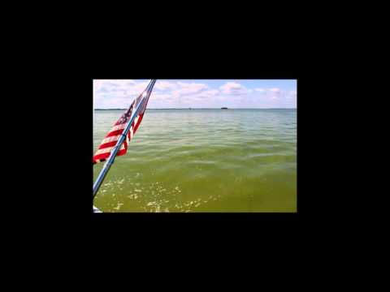
But sometimes that just leads to more confusion.
Notes:
We ran into something a few years ago - we were reporting on blooms of cyanobacteria and the toxin Microcystin that led to Toledo’s drinking water shut down. And we wanted to use the accurate term to describe cyanobacteria, but we kept running into scientists that used the term harmful algal bloom. I asked Jeff Reutter about this. He works at Ohio State University’s Stone Lab.

Slide 18
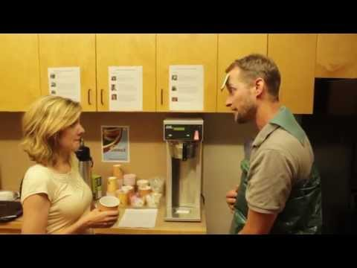
Cyanobacteria v. Algae
Notes:
Ever since we started using cyanobacteria to refer to Microcystis, it’s created confusion in our newsroom - Here’s one way my coworkers made fun of this mess.

Slide 19
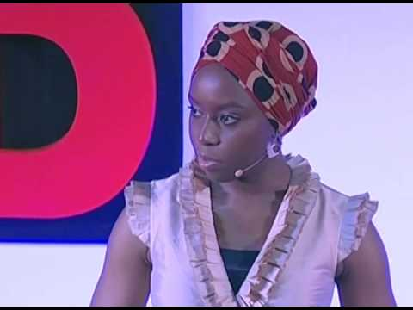
PITFALL # 2: The Danger of A single story.
Notes:
There’s always another side to the story. This is from a TED talk by Chimamanda Adichie (CHIM-ah-manda AH-DEECH-ee-ay). Author. Her talk demonstrates the importance of finding many voices and understanding the nuance in a story. You can’t always fit all those sides into a short story, but you can do that over time.

Slide 20
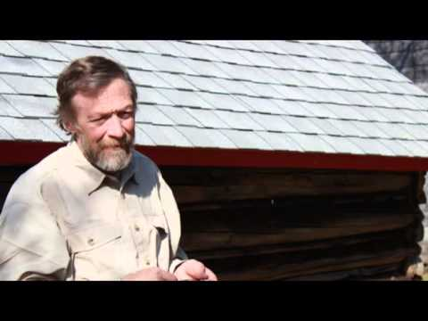
Embrace the gray areas.
“The simple story is
often irresistibly
attractive.”
Rolf Peterson, Michigan Tech
Notes:
Rolf Peterson has studied the wolves and moose on Isle Royale for 46 years. It’s the longest running study in the world of a predator and its prey. Rolf told us "The answers that you get after 10 or 20 or 30 or 50 years are entirely different from what they would've been after five years.”

Slide 21
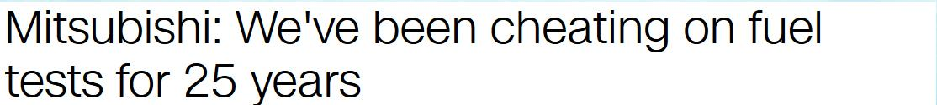
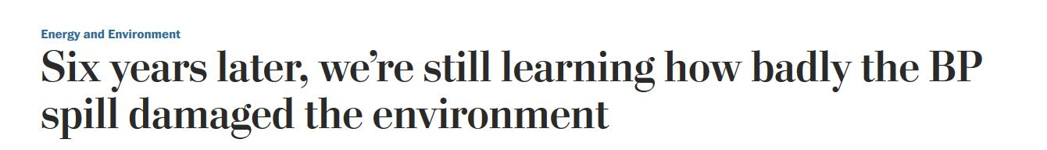
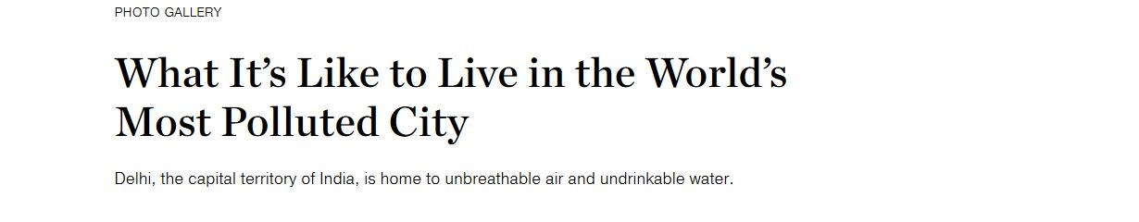
PITFALL #3: Environmental news can be the worst.
Notes:
I mean just look at these headlines. And these stories are crucial. We have to tell them and we need to hear them. But it’s easy to get overwhelmed as a listener or a reader. Also telling stories that connect with people on a personal level - something in their daily life, or introducing them to a person who’s doing something - taking action, doing even something small.

Slide 22
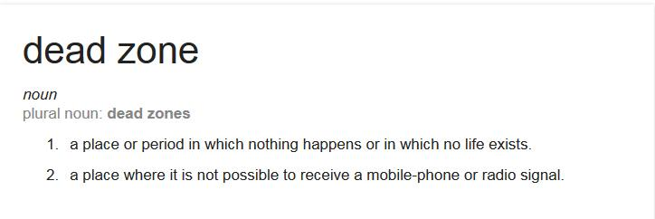
PITFALL # 4: Assumed knowledge
Notes:
When you say dead zone, most people are thinking cell phones. About a decade ago we did some focus groups. And we learned that we were assuming everyone in our audience had heard us talk about dead zones for years, and they knew that we were talking about places in a lake or ocean where nothing can survive. But in those focus groups, people didn’t know what we were talking about. It never hurts to be clear.

Slide 23
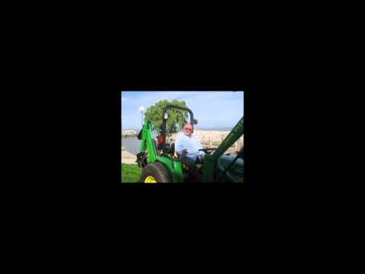
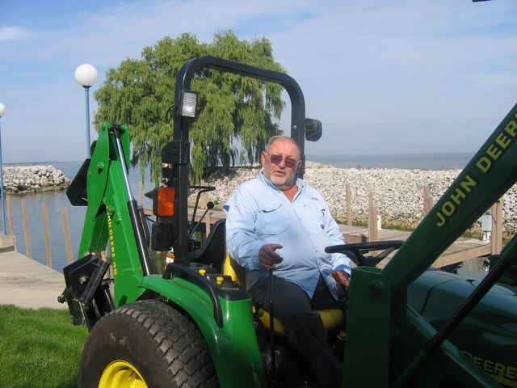
Making connections: finding what matters
Notes:
A kind of cyanobacteria called Lyngbya had taken over parts of Lake Erie in 2006 and 2007 - my coworker went to go talk with people who live along the Lake Erie coast..John Pastorek was using a tractor to get rid of the thick mats washing up on his property - he also talked about his beautiful green lawn that he was fertilizing with phosphorus. Here in this clip you hear Sandy Bihn of Lake Erie Waterkeeper trying to convince John Pastorek to stop using that kind of fertilizer so it wouldn’t feed the Lyngbya..

Slide 24
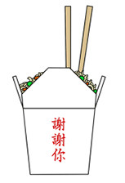
Take home message
Tell one story per story.
Start with a clear focus statement.
Be careful with jargon: define it if you use it.
Write like you talk. Be conversational.
Don’t be afraid to reveal your humanity.
Find out what matters to your audience and talk to them in a relatable way.

Slide 25

The Environment Report airs
Tuesdays and Thursdays
at 8:50am and 5:45pm

